Slide 1
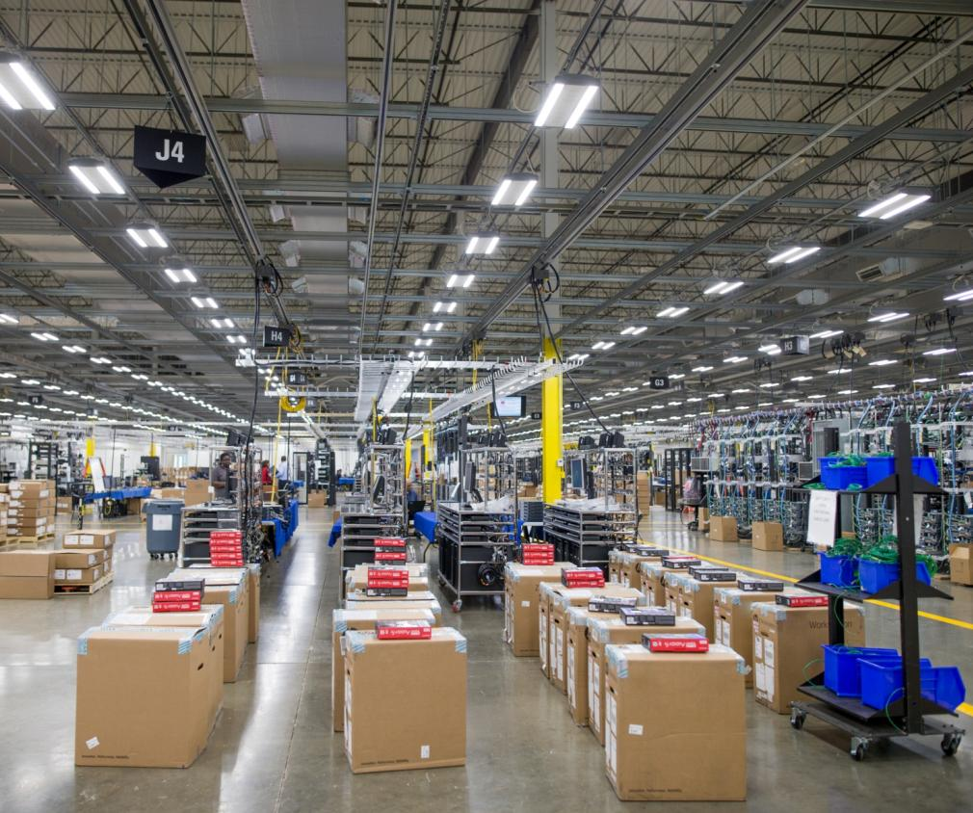

XT400 SERIES UNLICENSED TWO-WAY RADIOS
BUILT TOUGH TO DO BUSINESS BETTER

Slide 2
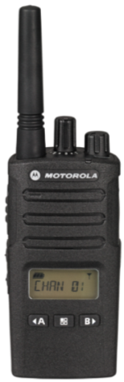
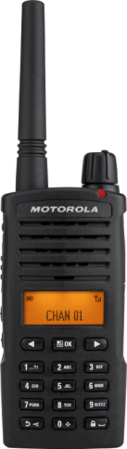

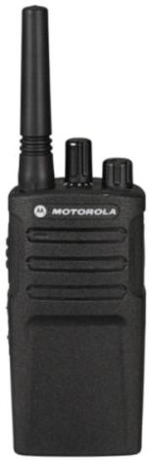
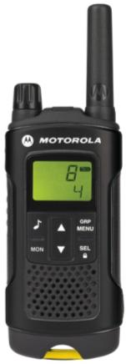
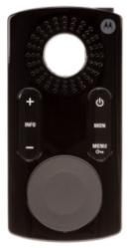
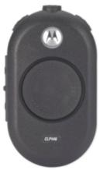
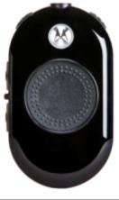

MOTOROLA SOLUTIONS
UNLICENSED BUSINESS RADIO PORTFOLIO
XT180
XT200 SERIES
XT220 / XT225
XT400 SERIES
XT420 & XT460
XT600d SERIES
XT660d & XT665d
CLP446
Bluetooth & Wired
CLK446
PMR446 & PLUS
MULTIPLE DEVICES SERVING MULTIPLE MARKETS

Slide 3
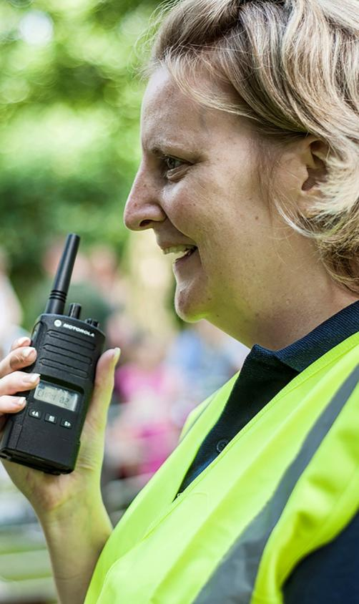

INTRODUCING XT400 SERIES
BUILT TOUGH TO DO BUSINESS BETTER
You need to communicate instantly without missing a beat – whether you’re coordinating resources at the construction site or monitoring production on the manufacturing line
The XT400 Series two-way radios have the business smarts to help your teams work better together

Slide 4





XT400 SERIES TARGET VERTICAL MARKETS
CONSTRUCTION
FACILITIES MANAGEMENT
MANUFACTURING
HOSPITALITY
EDUCATION
Coordinate site managers, contractors and trades people to keep projects on track
Clear, loud audio means the message gets through and channel announcement allows you to communicate instantly with different teams efficiently and without them having to remove the radio from their belt.
Improve staff responsiveness from the ground up
The XT400 Series helps building managers, maintenance technicians, groundskeepers and security personnel respond quickly to requests and incidents to minimise costs and increase tenant satisfaction.
Hear above heavy equipment and high noise
Clear communication in noisy environments is essential to avoid downtime and respond quickly to problems or injuries. With exceptional audio and rugged construction, the XT400 Series is ideal for multi-shift operations.
Deliver excellent service and customer satisfaction
Keep staff connected, from the front desk and concierge to event planners and maintenance personnel. XT400 Series helps boost staff productivity by enabling fast response to guest needs, special events, spills and emergencies.
Stay in touch to help maintain order and enhance student safety
For everyone from teachers & administrators, to crossing patrol officers and maintenance teams. XT400 Series enables rapid response to any situation and helps prevent small problems escalating into bigger ones.

Slide 5
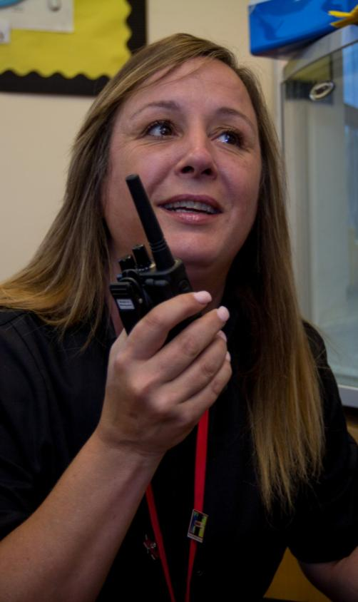
ENHANCED DURABILITY
PMR446 FREQUENCIES
LOUD, CLEAR AUDIO
CHANNEL ANNOUNCEMENT
LONG BATTERY LIFE

Slide 6
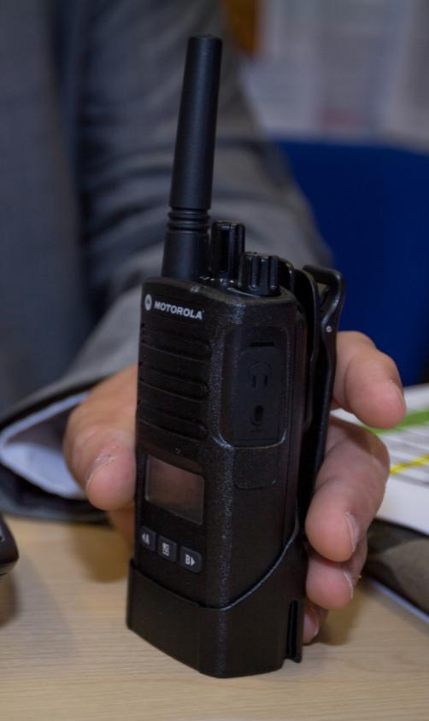
WHAT’S NEW
IN THIS RELEASE
16 ANALOGUE PMR446 CHANNELS
  Increased from 8 to 16 channels¹
  Supports PMR446 frequencies from 446.00625 to 446.19375 MHz (8 new channels require CPS license key)
VOICE ANNOUNCEMENT IN 10 LANGUAGES
  Now Supports English, French, Spanish, Italian, Russian, Dutch, Portuguese, German, Polish, Turkish
  Previously only available in English
6 CALL ALERT TONES
  Increased from 3 to 6 call tones
¹ Where permitted by local country law. Restricted to 8 channels in Russia by law.

Slide 7

ENHANCED DURABILITY
XT400 SERIES IS DESIGNED TO MAXIMISE PERFORMANCE AND MINIMISE COSTLY REPAIRS AND DOWNTIME
XT400 Series is IP55 rated and meets
US Military Standard 810 C, D, E, F and G
Also subjected to Motorola Solutions’ unique ACCELERATED LIFE TESTING (ALT). This rigorous laboratory procedure simulates up to 5 years of field use
BLOWING RAIN
Steady rainfall and wind for
30 minutes on every surface
VIBRATION
Up to 9 hours exposure to vibration simulates the rigors radios undergo while being carried or transported
SALT FOG
48 hours of exposure
BLOWING DUST
Six hours of blowing dust on all surfaces
SHOCK
18 shocks with a minimum G force of 40 G each
TEMPERATURE
Exposure to extreme storage temperatures from -55°C to 70° C

Slide 8

PMR446 UNLICENSED
FREQUENCIES
XT400 SERIES RADIOS UTILISE ALL
16 ANALOGUE PMR446 FREQUENCIES¹ FOR EASY, COST EFFECTIVE OPERATIONS.
No subscription or call charges and 16 channels¹ with 219 privacy codes help ensure a clear signal and give greater options to reduce interference from others
XT400 SERIES radios are also compatible with any other radio operating on the same PMR446 frequencies
¹ Where permitted by local country law. Restricted to 8 channels in Russia by law.

Slide 9

LOUD CLEAR AUDIO
HEAR MESSAGES CLEARLY, EVEN
IN NOISY ENVIRONMENTS
Powerful 1500mW audio output
helps messages be heard, even
in noisy environments
User can easily adjust audio
output to suit background noise
levels using volume control knob

Slide 10

CHANNEL ANNOUNCEMENT
INTERACT EASILY
Customised channel announcements tell you which channel you’re on when you change it, so you can concentrate on serving customers, not removing the radio from your belt to see the channel
Select from 16 pre-recorded channel names⁵ in 10 languages⁶ or upload your own audio file for personalised channel names
Text to voice feature reads out channel alias defined by CPS
⁵ OFF (Default), Admin, Back Room, Cashiers, Customer Service, Emergency, Janitorial, Maintenance One, Maintenance two, Medical, Picking, Receiving, Security One, Security Two, Shop Room, Supervisor, Warehouse
⁶ English, French, Spanish, Italian, Russian, Dutch, Portuguese, German, Polish, Turkish

Slide 11
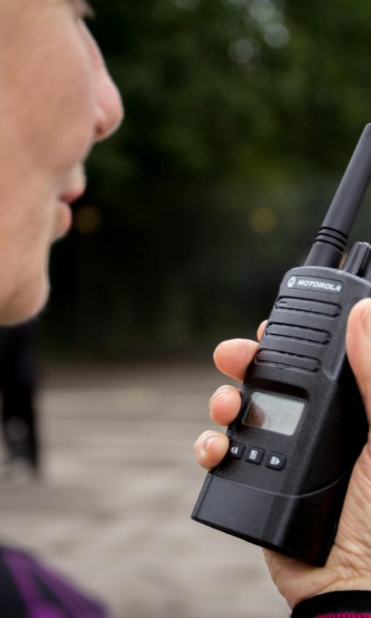
LONG BATTERY LIFE
THE XT400 SERIES’ CUSTOM-DESIGNED
LI-ION BATTERY PACKS ARE BUILT TO
ENSURE DURABILITY
XT400 Series radios ship as standard
with a 2150 mAh Li-Ion battery
providing up to 20 hrs of life³
Optional high capacity battery is
available for longer runtime
³ Operating 5/5/90 usage pattern with standard capacity battery and battery save feature on.

Slide 12
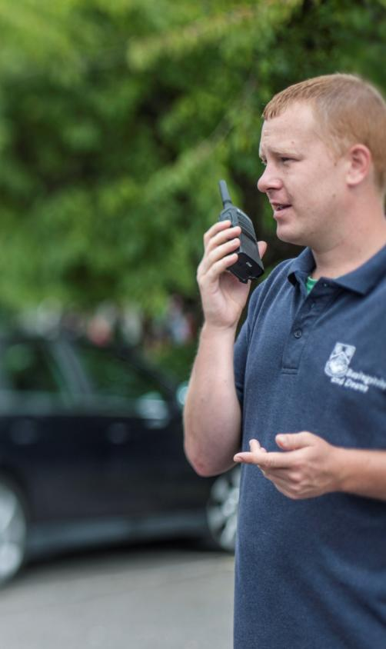
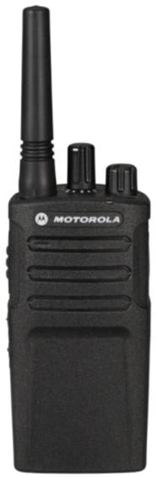
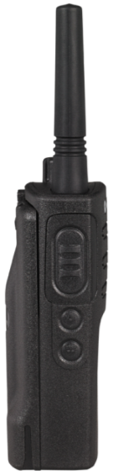



XT420 NON-DISPLAY RADIO
Antenna
Channel Selector
On/Off Volume Knob
LED Indicator
Microphone
Accessory Connector
PTT (Push-
to-Talk) Button
Rugged Speaker Grill
Side Button 1*
Side Button 2*
Lithium Ion Battery
* Side buttons can be programmed for Monitor, Scan/Nuisance Channel Delete, Call Tone, Scramble or No Operation

Slide 13
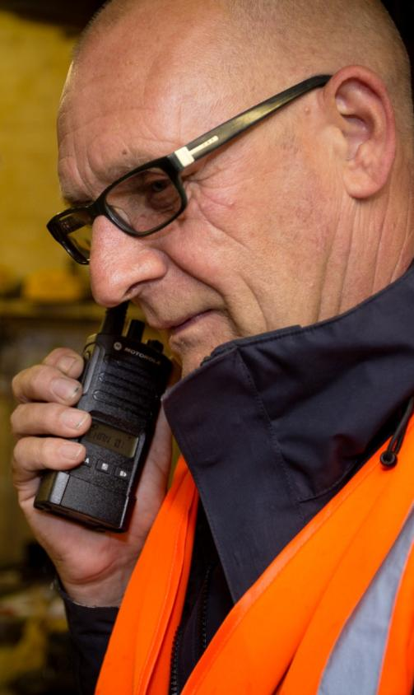
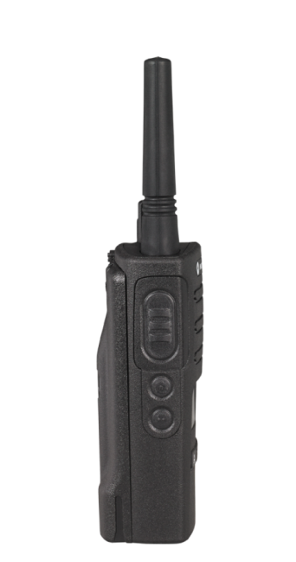
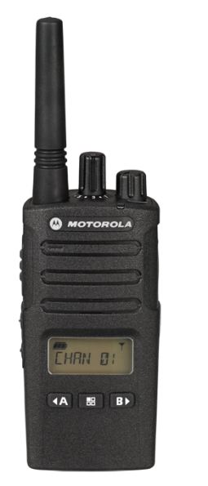


XT460 NON-DISPLAY RADIO
Antenna
Channel Selector
On/Off Volume Knob
LED Indicator
Microphone
Accessory Connector
PTT (Push-
to-Talk) Button
Rugged Speaker Grill
Side Button 1*
LCD Display
Side Button 2*
Menu button
Use to lock keypad
Lithium Ion
Battery
Front Buttons
Use < and > to scroll
up/down menu settings
* Side buttons can be programmed for Monitor, Scan/Nuisance Channel Delete, Call Tone, Scramble or No Operation

Slide 14
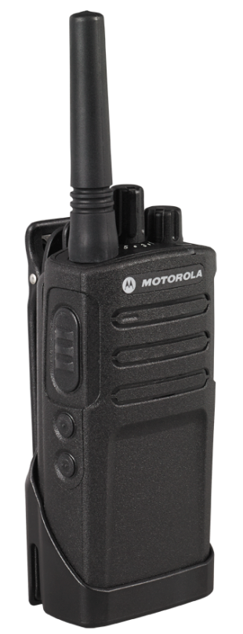
XT420 FEATURE LIST
16 Channels¹
219 Privacy Codes
Channel Voice Announcement
Channel Voice Alias Via CPS
Power Up Audio
  Tone Only + Channel
  Battery Level + Channel
  Silent
1500mW Audio Output
Hands Free VOX
Antimicrobial Coating
Programming With Voice Prompts
16 Position Channel Selector
On/Off/Volume Knob
2 Programmable Side Buttons
Autoscan
6 User Selectable Call Tones
Scan and Scan List
Voice Scrambling
IP55, MIL STD810 C,D,E,F&G
Coverage 16,250m², 13 Floors or 9km Line of Sight (coverage will vary based on terrain and conditions)
¹ Restricted to 8 channels in Russia by law

Slide 15
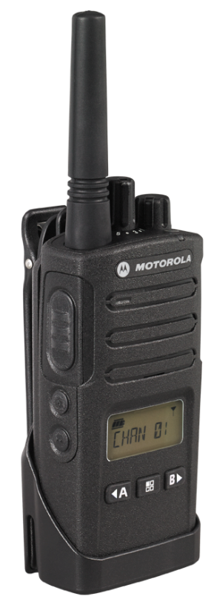
XT460 FEATURE LIST
16 Channels¹
Two-line Display
219 Privacy Codes
Channel Voice Announcement
Channel Alias Text And Voice
Channel Voice Alias Via CPS
Power Up Audio
  Tone Only + Channel
  Battery Level + Channel
  Silent
1500mW Audio Output
Hands Free VOX
Antimicrobial Coating
Programming With Voice Prompts
16 Position Channel Selector
On/Off/Volume Knob
2 Programmable Side Buttons
Autoscan
6 User Selectable Call Tones
Scan and Scan List
Voice Scrambling
IP55, MIL STD810 C,D,E,F&G
Coverage 16,250m², 13 Floors or 9km Line of Sight (coverage will vary based on terrain and conditions)
¹ Restricted to 8 channels in Russia by law

Slide 16
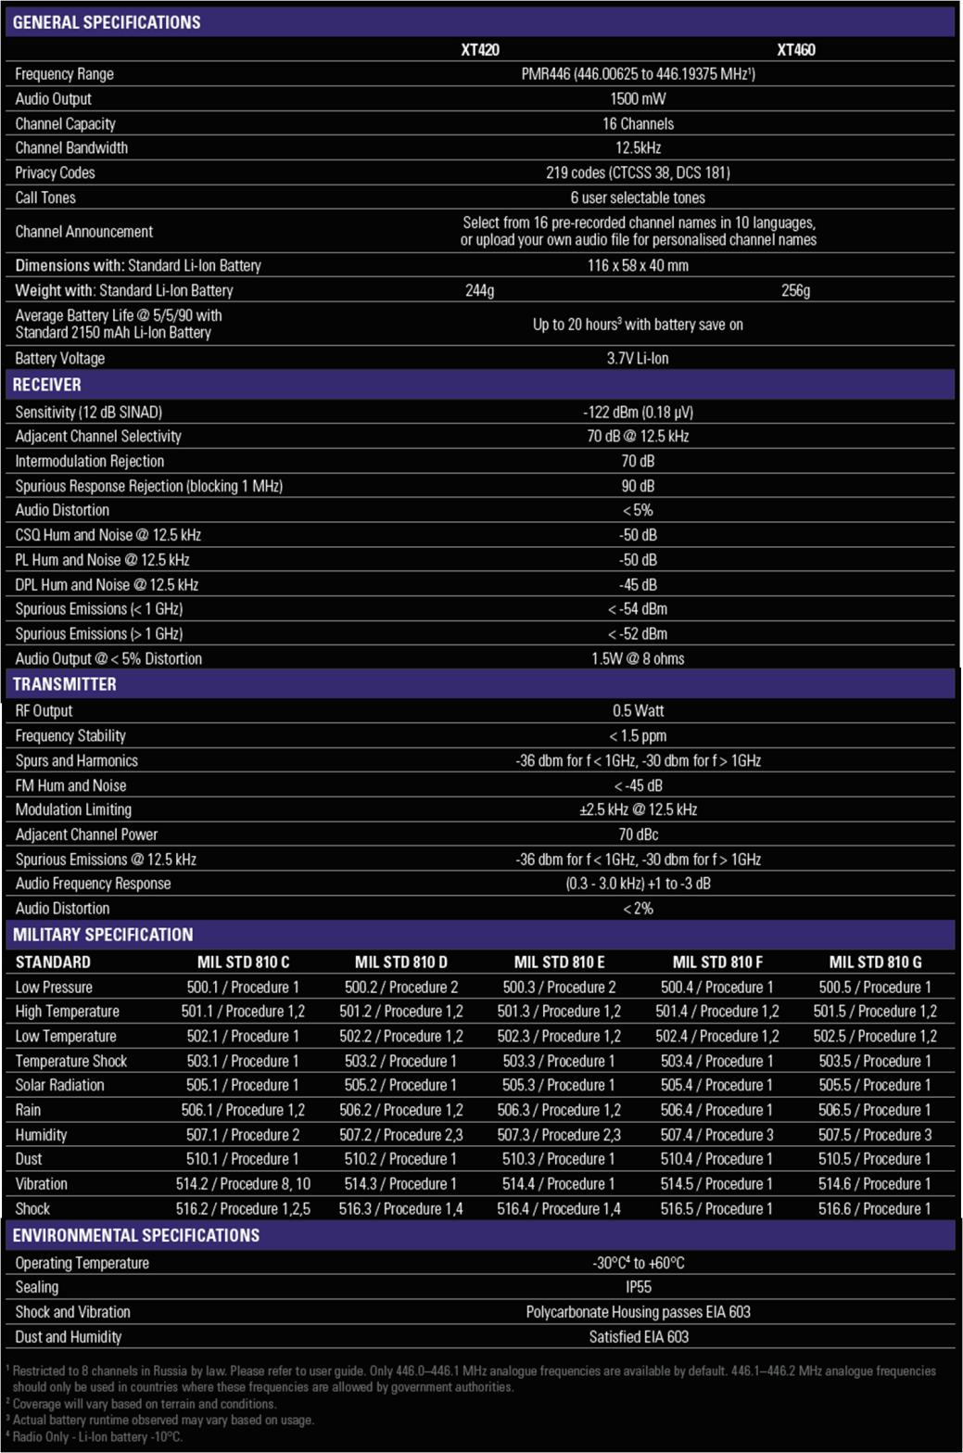
XT400 SERIES SPECIFICATIONS

Slide 17
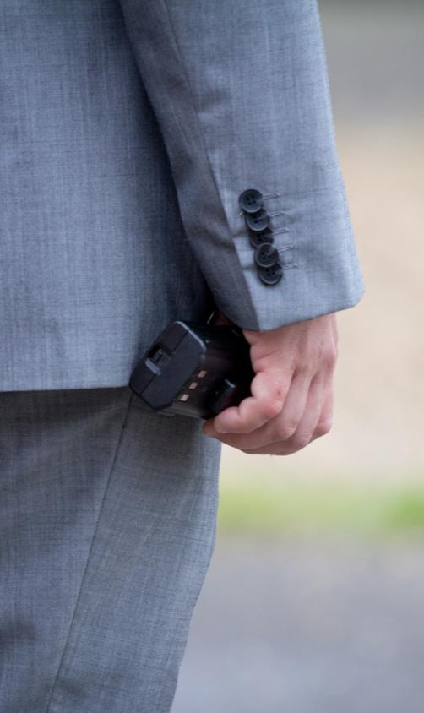
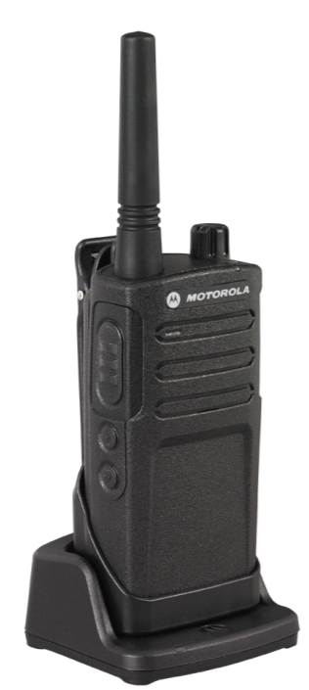
XT400 SERIES STANDARD PACKAGE
Also included:
User Guide and
Safety Manual
XT400 Series Radio and Standard Li-Ion Battery
Drop-in Charging Tray
and Power Supply
(Option - also available without charger in the box)
Swivel Holster

Slide 18
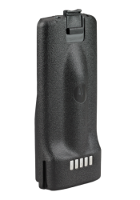
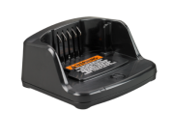
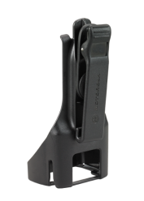
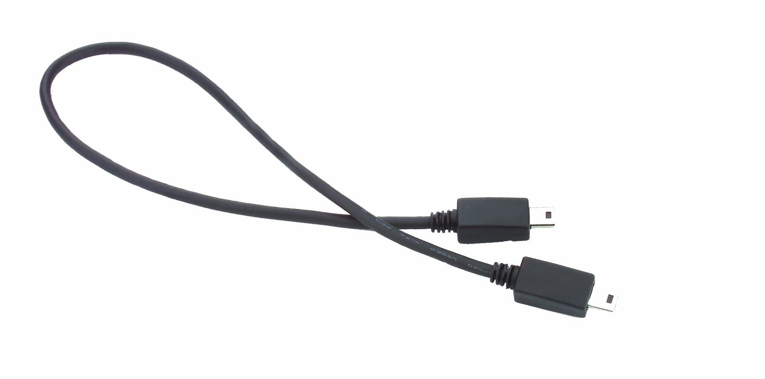
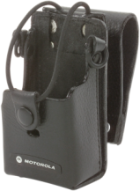
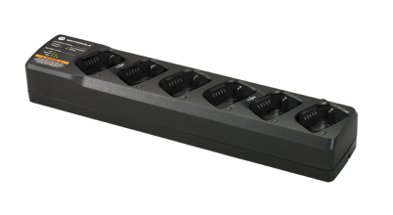
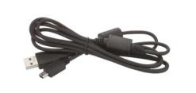
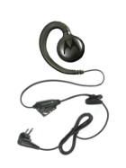
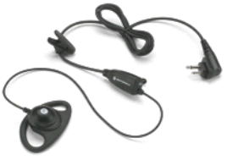
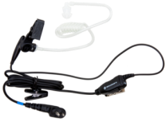
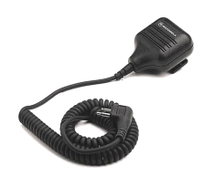
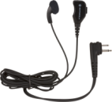
XT400 SERIES ACCESSORIES
ENERGY
CARRY
PROGRAMMING
Single Unit Charger PMLN6393
Radio to Radio Cloning Cable HKKN4028
Multi-Unit Charger
PMLN6385
CPS Programming Cable HKKN4027
Standard
Li-Ion Battery PMNN4434
High Capacity
Li-Ion Battery PMNN4453
Swivel Holster HKLN4510
Hard Leather Carry Case RLN6302
AUDIO ACCESSORIES
Remote Speaker
Microphone HKLN4606
Earbud with
In-line PTT
HKLN4605
Swivel
Earpiece HKLN4604
Earpiece with In-line PTT & Microphone HKLN4599
Transmit and Receive Surveillance Kit with Comfortable Translucent Tube HKLN4601

Slide 19
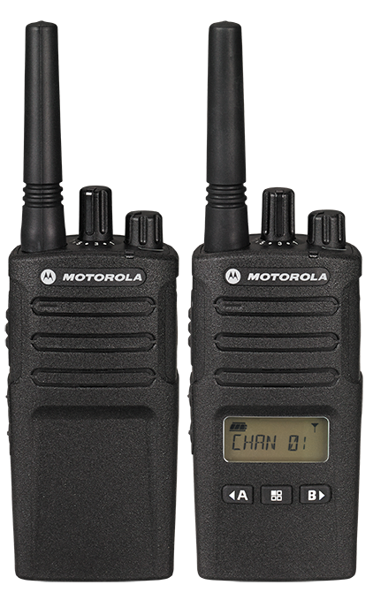
XT400 SERIES
BUILT TOUGH TO DO BUSINESS BETTER

Slide 20

www.motorolasolutions.com/XT400
Motorola Solutions Confidential - Do Not Redistribute - PartnerEmpower Member, Customer, and Prospective Customer Use Only.
Motorola Solutions Ltd. Nova South, 160 Victoria Street, London, SW1E 5LB, United Kingdom.
Availability is subject to individual country law and regulations. All specifications shown are typical unless otherwise stated and are subject to change without notice.
MOTOROLA, MOTO, MOTOROLA SOLUTIONS and the Stylized M Logo are trademarks or registered trademarks of Motorola Trademark Holdings, LLC and are used under license.
All other trademarks are the property of their respective owners. ©2019 Motorola Solutions, Inc. All rights reserved. v2(02/19)

